Slide 1
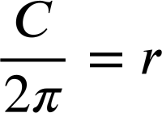
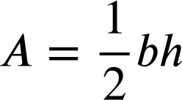

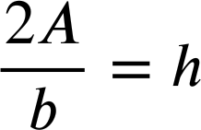
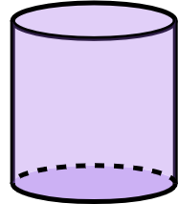
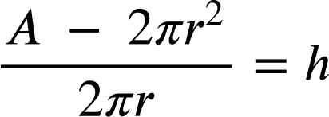
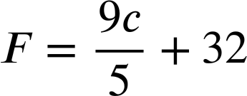
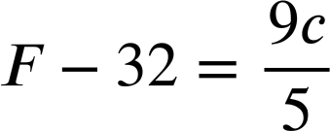



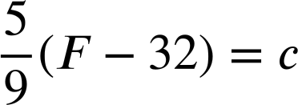
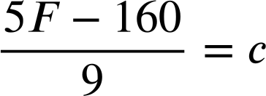
Changing the subject to suit the context
Task A: Rearranging additive and multiplicative steps
1) a) Rearrange the formula for circumference of a circle so that it would be more efficient for finding the radius if you knew the circumference.
C
C = 2πr
r
r, the unknown we want to find, is now the subject.
1) b) Rearrange the formula for area of a triangle so that it would be more efficient for finding the height if you knew the area and the base.
Height
Base
h, the unknown we want to find, is now the subject.
1) c) Rearrange the formula for surface area of a cylinder so that it would be more efficient for finding the height if you knew the surface area and radius.
r
A = 2πr² + 2πrh
h
A − 2πr² = 2πrh
h, the unknown we want to find, is now the subject.
2) This is the formula for converting Celsius into Fahrenheit.
Show two ways to rearrange the formula so that it converts Fahrenheit into Celsius.
Step one:
−32 both sides
Step one:
×5 all terms

Slide 2
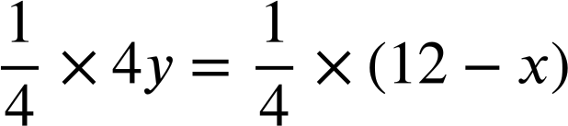
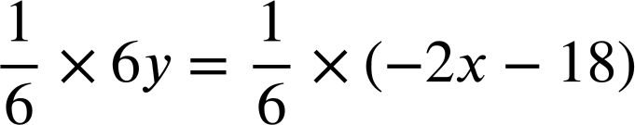
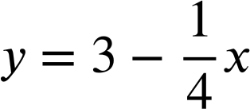
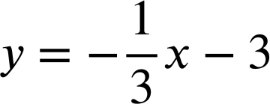


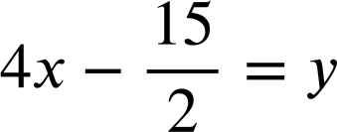
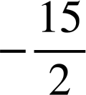
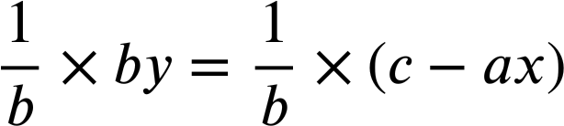
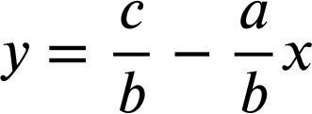


Changing the subject to suit the context
Task B: Rearranging equations to find the gradient
1) Work out the gradient and the y-intercept of the lines given by these equations by rearranging to make y the subject.
a) x + 4y = 12
b) 2x + 6y = −18
4y = 12 − x
6y = −2x − 18
Gradient , y-intercept 3
Gradient , y-intercept −3
c) 8x − 2y = 15
8x = 15 + 2y
8x − 15 = 2y
Gradient 4, y-intercept
2) Rearrange this general form of a linear equation to make y the subject and find an expression for the gradient and y-intercept when in this form.
ax + by = c
by = c − ax
For the form ax + by = c the gradient is
and the y-intercept is
Mathematics in Education and Industry
v2.3

